Slide 1
Screenshot Evidence from my DFESW6 Spring Drinks Project
Martin Palmer, BA MA

Slide 2
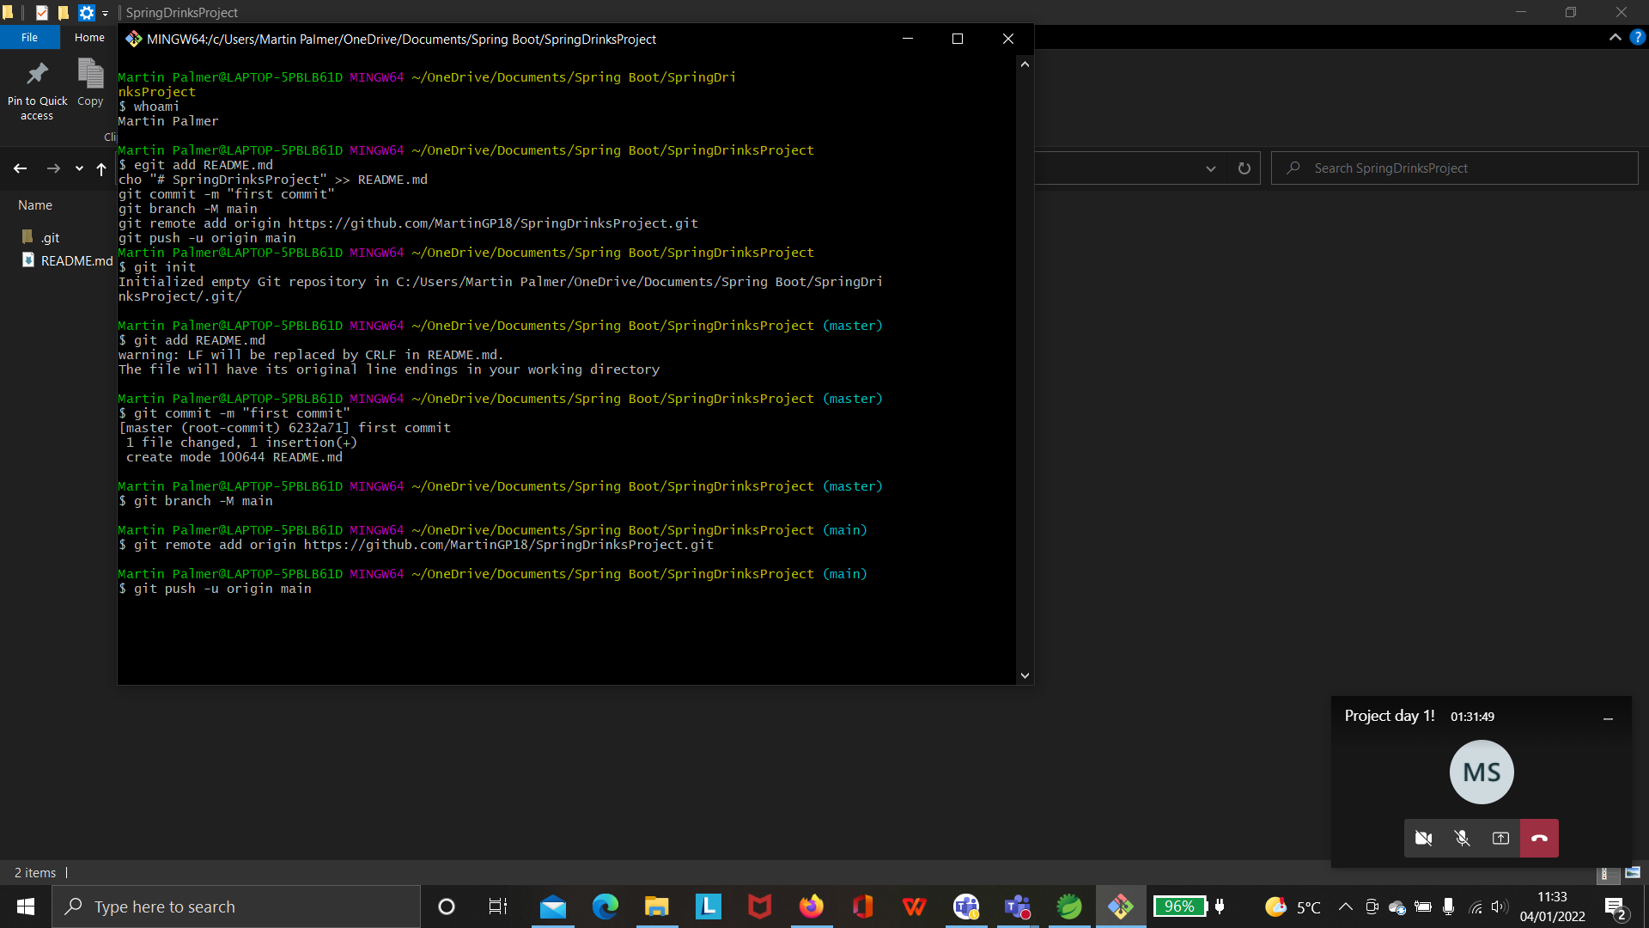
Initialising my GitHub repository:

Slide 3
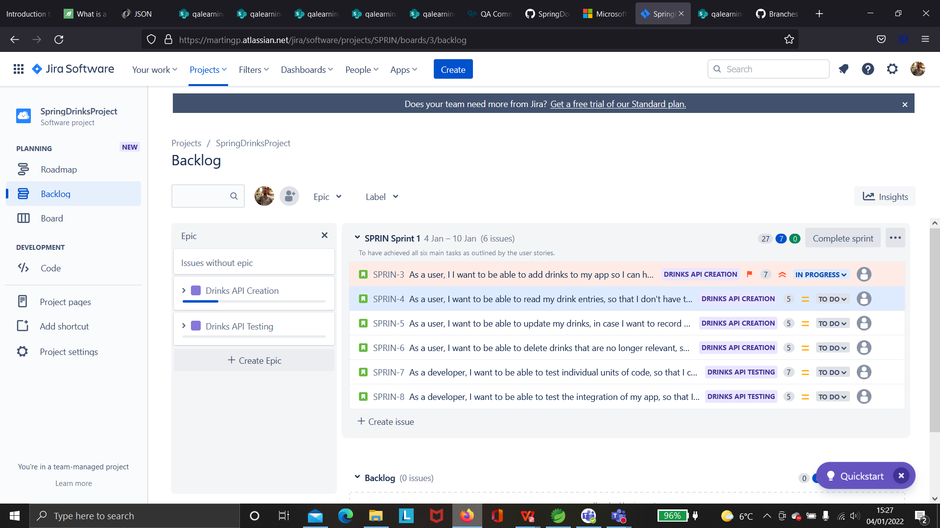
Populating my Jira board with user stories, with priorities, story points, and acceptance criteria:

Slide 4
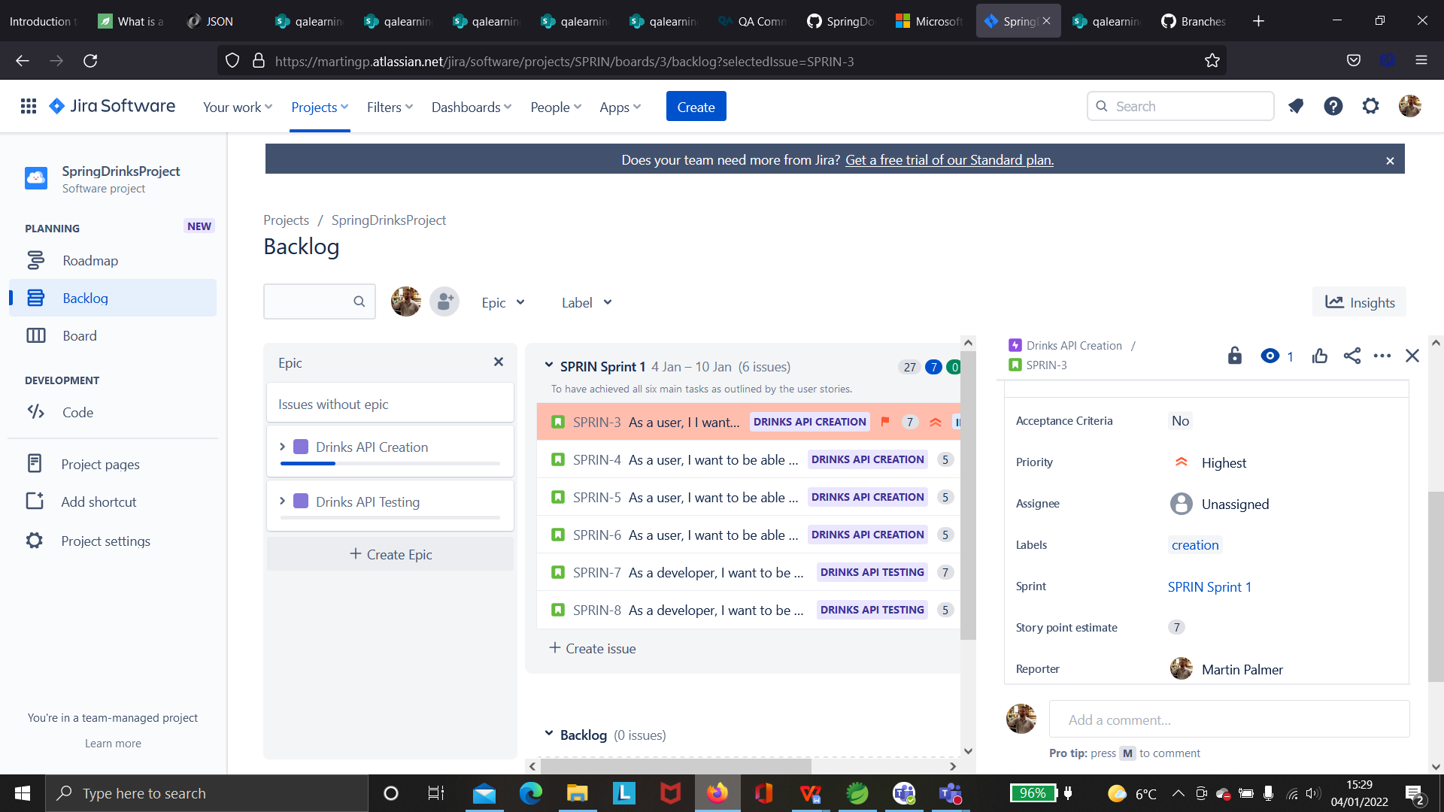
Highlighting the user story options:

Slide 5
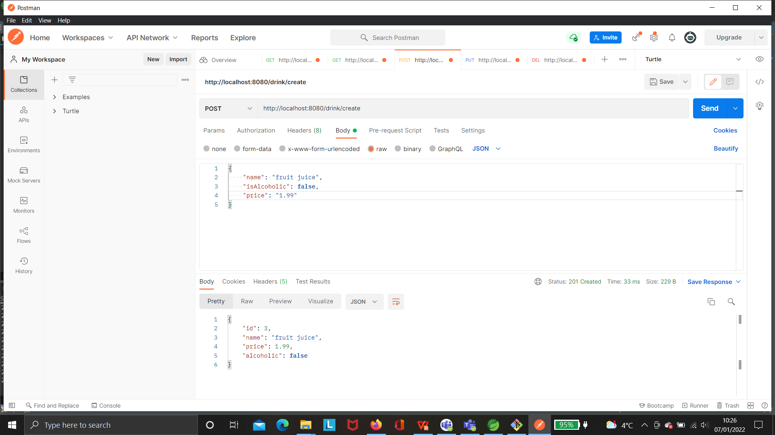
Postman: Create

Slide 6
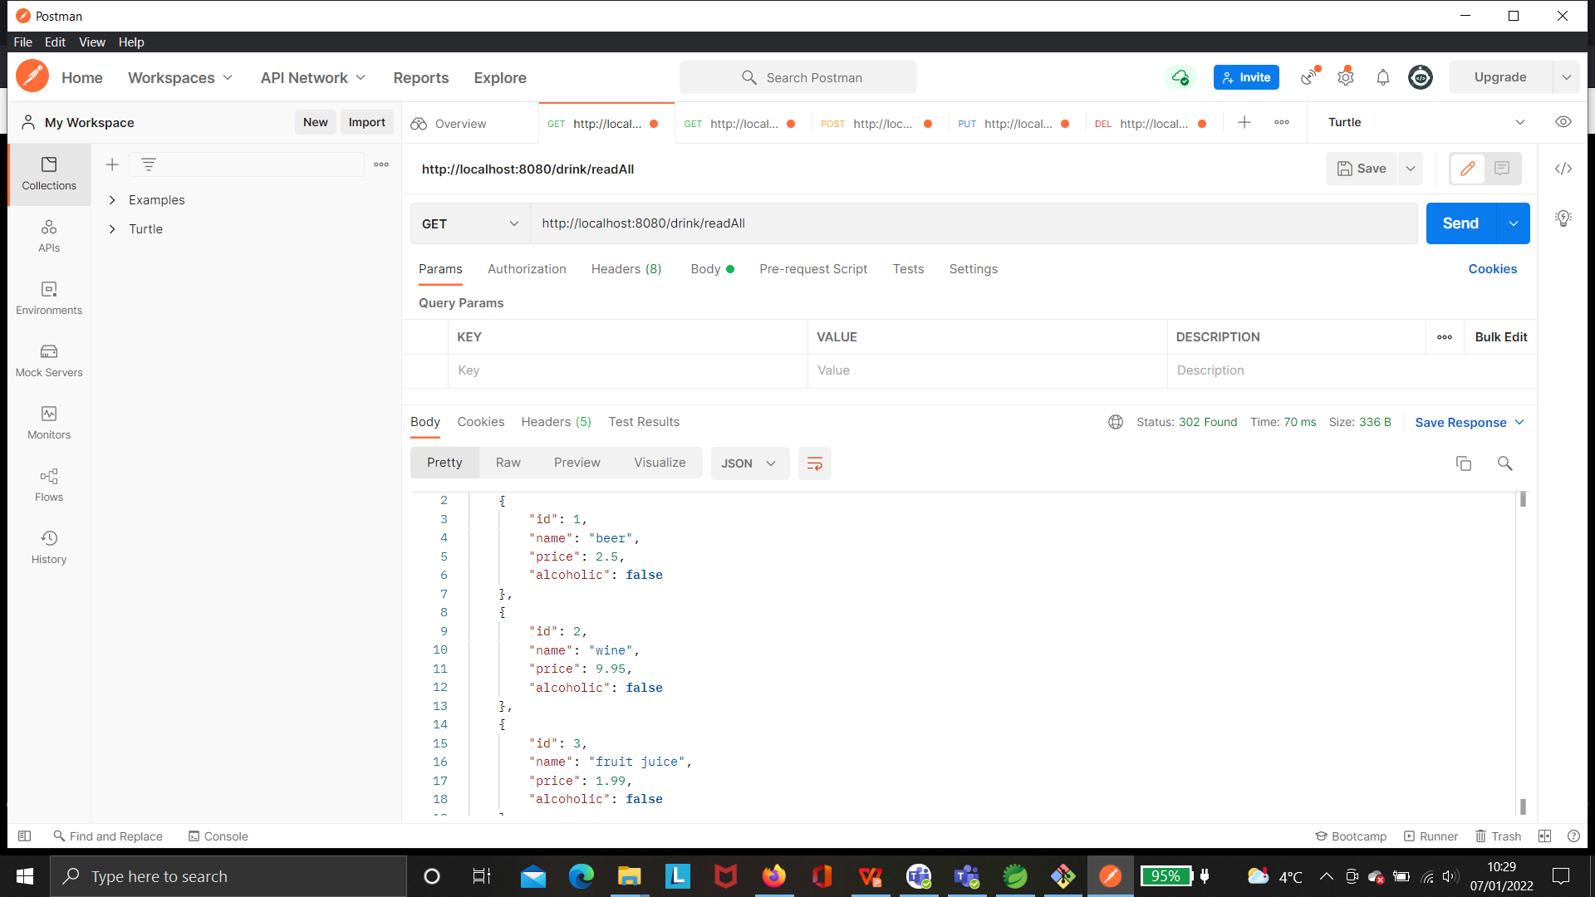
Postman: ReadAll:

Slide 7
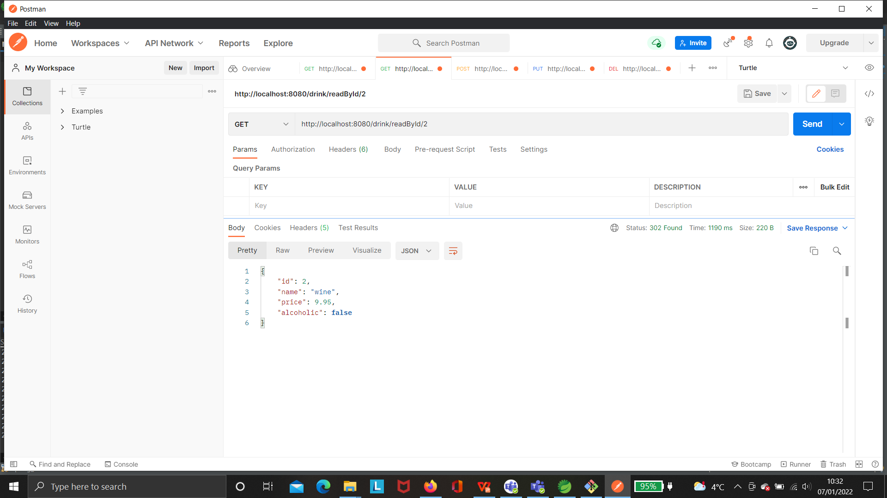
Postman: ReadById
Initially I had messed up by having the Map as “/readByID/{id}”, with ID fully capitalised, so that when I used the above link in Postman, it did not recognise what I wanted.

Slide 8
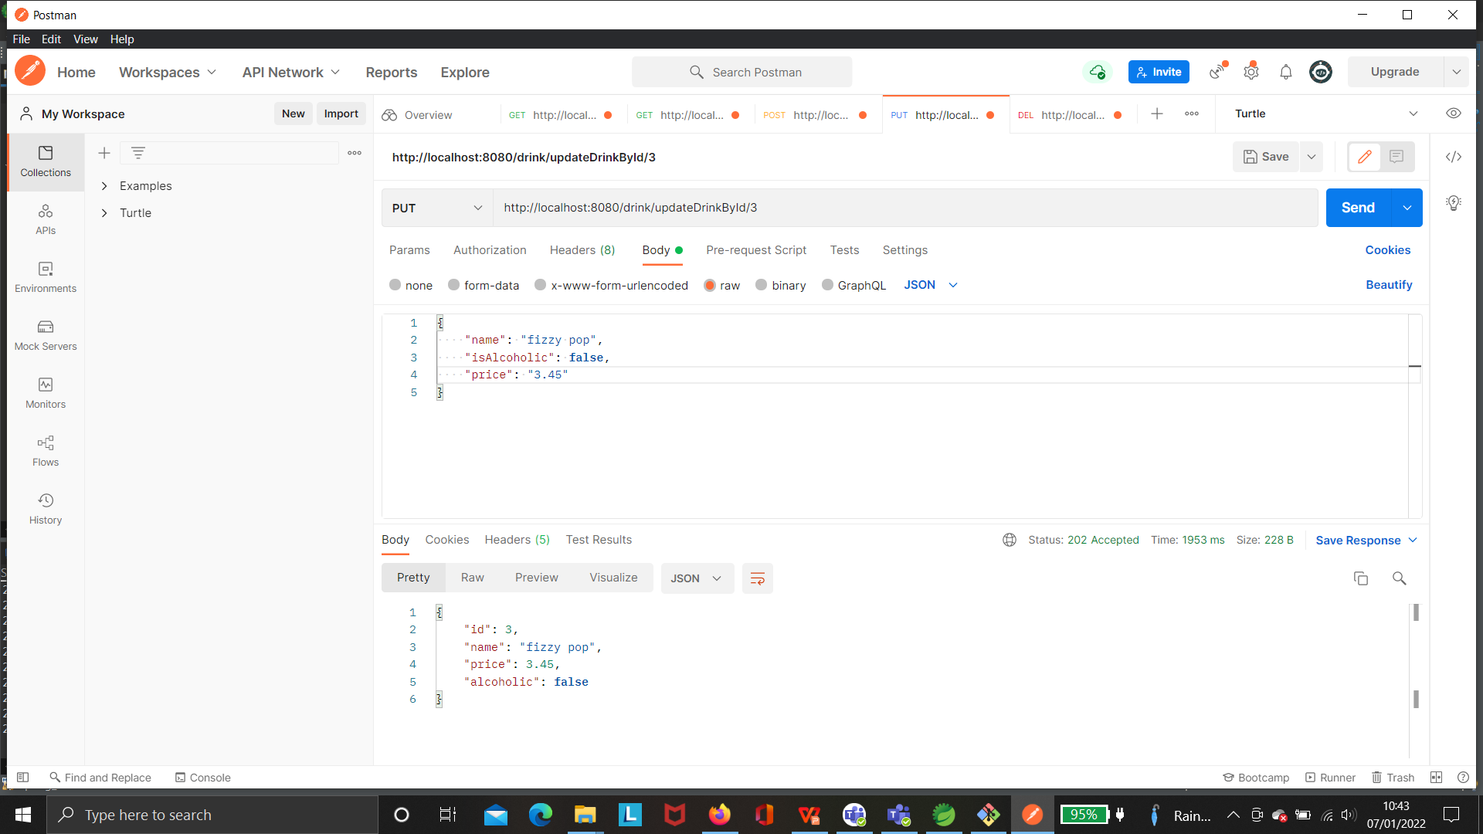
Postman: Update:

Slide 9
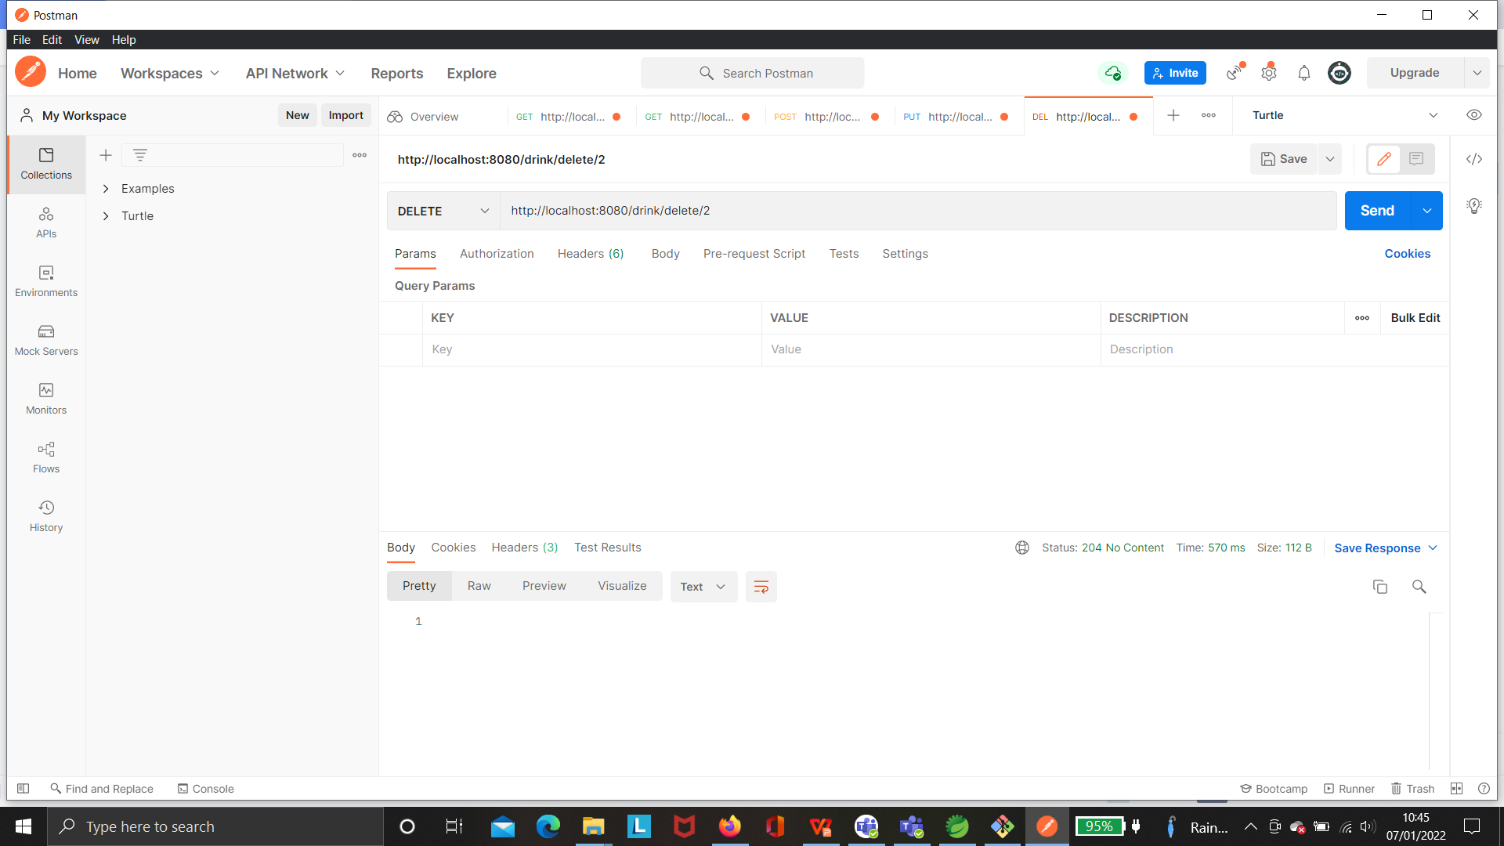
Postman: Delete

Slide 10
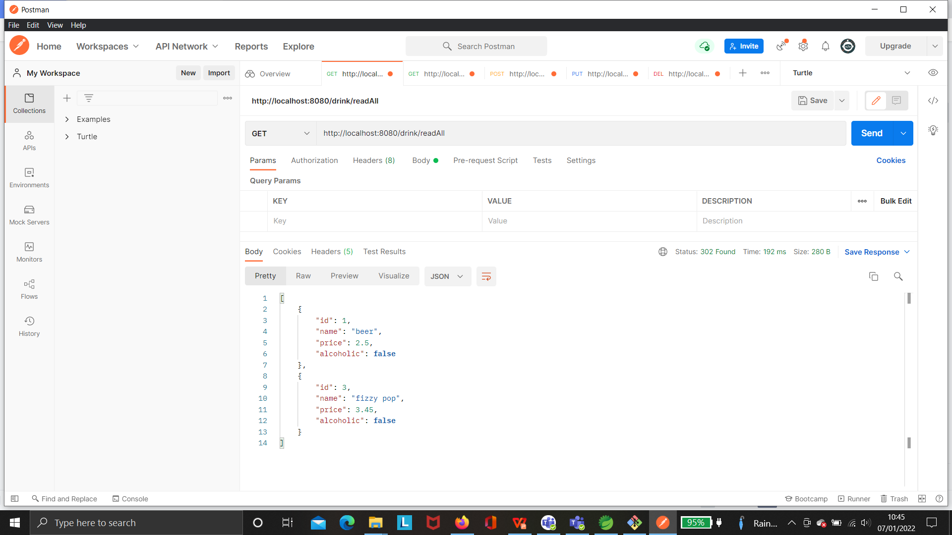
Postman: Updated getAll:

Slide 11
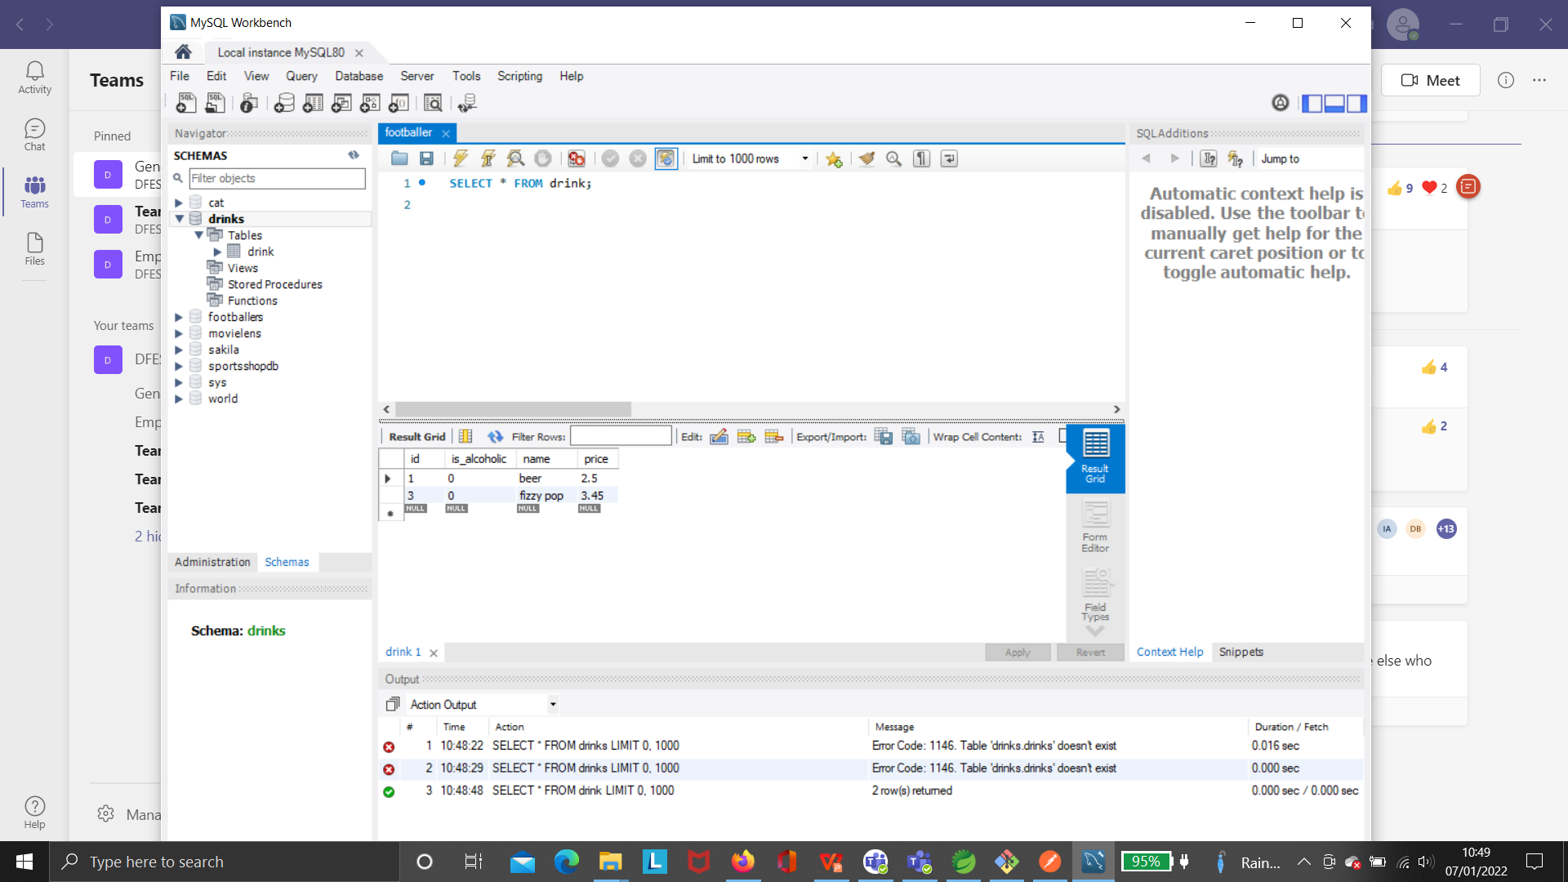
MySQL Database Persistence:

Slide 12
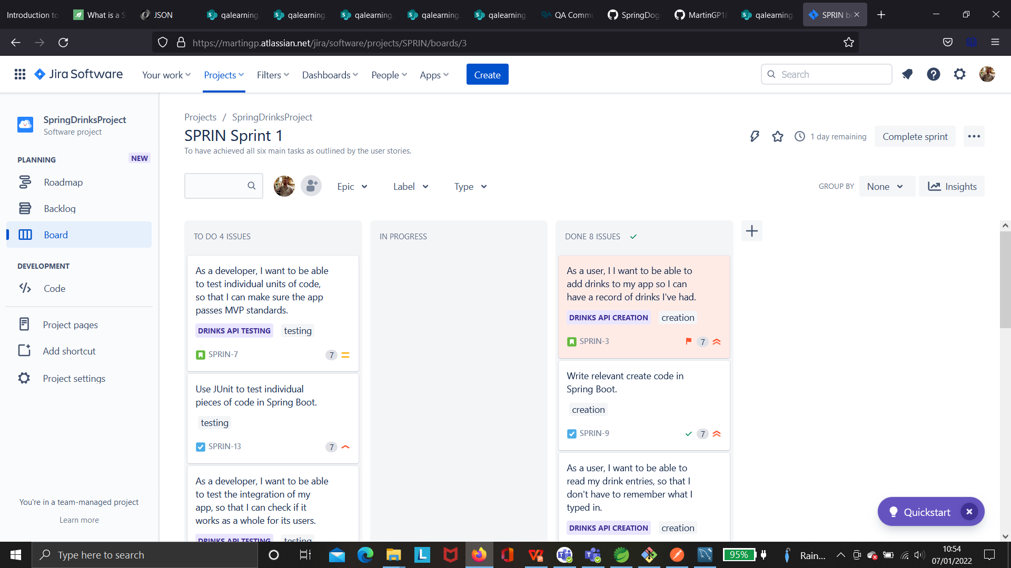
Updating my Jira Board:

Slide 13
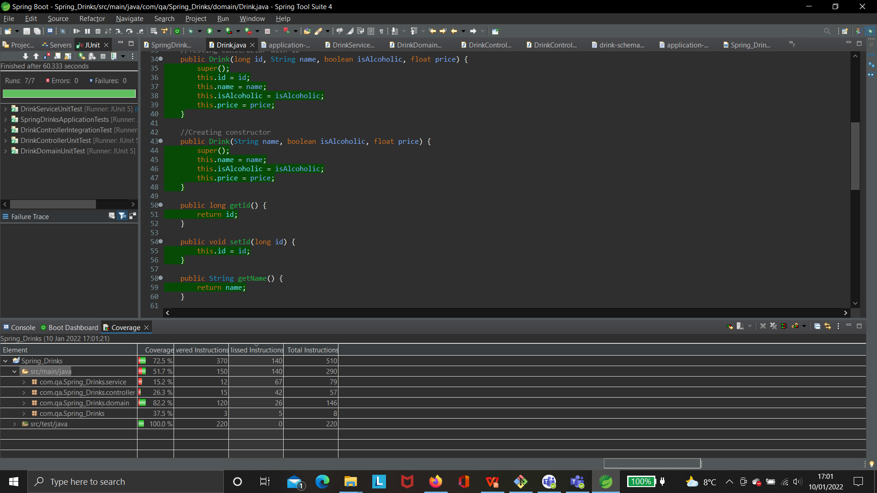
JUnit Testing Coverage

Slide 14
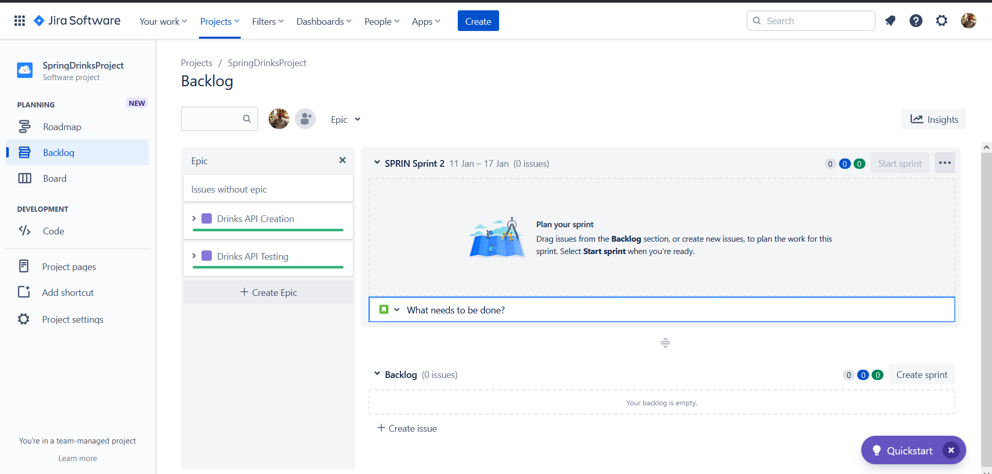
Completed Sprint

